Slide 1

Working Title: Puzzle Dots
Jeffrey Petersen - Product Owner,
Vanda Pandhumsoporn,
Connor Dunham,
Adam Henry

Slide 2
Puzzle Dots Preamble
A puzzle game made in HTML5 with Javascript about directing the behavior of dots.
The game offers short levels with varying complexity and replayability through finding improved solutions.

Slide 3
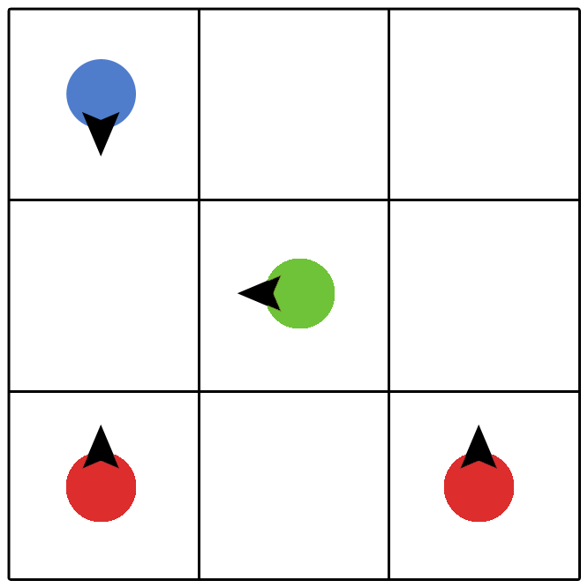
Puzzle Dots Game Concept
Pieces move in different directions.
Players strike two compatible pieces to combine them into a new piece.
Forming a new piece through gameplay is called a reaction.
Via experimentation, a player learns new combinations.
The goal is to bring all pieces into their designated squares.

Slide 4
Project Release Plan - User Stories
Puzzle Dots
Sprint 1 (Alpha) | High Level Goal Working prototype that can be used across the team for testing each part of the program. | SP
As a product owner, I want a prototype that can demonstrate the core features of the game, so I know it is heading in the right direction. | Sample level code | 13
As a product owner, I need an integration system, so the team can collaborate. | Continuous integration using Git | 2
As a product owner, I want potential features demonstrated, so I can decide how to prioritize development. | Feature prototyping | 5
Notes:
Sprint 1
(5 SP) As a player, I want to play a basic level so I can have fun.
High level goal: Level Progression
(3 SP) As a player, I need guidance on how to play so I can learn the controls.
HLG: Test driven code implementation (Game playtesting, concept and application) and get feedback
(2 SP) User Story 1: As a product owner, I need to set up an integration system for the team so we can collaborate.
HLG: Continuous integration using Git.
(8 SP) User Story 2: As a product owner, I want to prototype the game and so I can learn about user interaction.
HLG: Prototype testing

Slide 5
Project Release Plan - User Stories
Puzzle Dots
Sprint 2 (Beta) | High Level Goal All critical functionality implemented for having a playable game | SP
As a player I want the game to recognize I am a winner so I can feel accomplished. | Fully functional GUI | 2
As a product owner, I want a fully functional level, so I can begin testing the game on potential players. | Fully functional gameplay Fully functional GUI Product testing | 8
As a product owner, I want a solid idea of what can be included in the final release, so that I can begin pitching the game. | Finalized features for release | 3
As a player, I want a menu screen so I can choose which level I want to play. | Fully functional GUI | 5

Slide 6
Project Release Plan - User Stories
Puzzle Dots
Sprint 3 (Release) | High level Goal | SP
As a player I want a progression of levels, so I can learn how to play and be challenged as I progress. | Level Progression | 5
As a product owner, I want the release to be thoroughly tested, so I know it won’t crash on users | Product Testing | 3
As a player, I want to save my game state, so I can return to it later. | Level Progression | 2
As a player, I want to see how well I did on a level, so I can try to improve and compete with friends. | Score System | 2
As a product owner, I want a credits screen, so the development team can let people know they made the game. | Credits Screen | 2
As a player, I want the game to look and sound good, so I can enjoy it more. | Art, Audio, Animations | 8
As a player, I want a responsive game, so I don’t become frustrated and lose interest. | Optimization | 1
Notes:
Sprint 3
(5 SP) As a player, I want an addicting game that saves my play state so I can return to it later.
HLG: Test driven code implementation (Game playtesting, concept and application)
(8 SP) As a player, I want to be able to play this game on my phone or tablet so I can play on the go.
HLG: Available to play games on different platforms
(3 SP) As a player, I want the puzzles to show solutions so that when I am stumped I can continue to the next level.
HLG: Get feedback and suggestions from users/players

